Slide 1


TECHNOLOGY ENTREPRENEURSHIP
COMPUTER SCIENCE ENGINEERING (AI & ML)
Team No. 16
Roll Number
Roll number
Name of the Student
25885A6615
B.Tejasri
25885A6616
B.Shiva
25885A6618
P.Anil
25885A6619
R.Architha
Under the Supervision of
Mr. G Krishna Teja
Ms.Sirisha
Assistant Professor
Department of ECE
Assistant Professor
Department of ME

Slide 2

Microplastic Detection in Water using Arduino-Based Laser Scattering

Slide 3
The Unseen Threat: Microplastic Pollution
Ecosystem Disruption
Bioaccumulation
Human Consumption
Microplastics can harm aquatic life by blocking digestive tracts or leaching toxic chemicals, leading to malnutrition and reduced growth.
Small organisms ingest microplastics, which then move up the food chain, affecting larger species, including those consumed by humans.
Microplastics are found in drinking water, seafood, and salt, potentially entering the human body unknowingly and posing health risks.
Toxicity Risks
Cellular Damage
Detection Difficulty
These particles can carry harmful chemicals like BPA, phthalates, and heavy metals, which can be released into the environment and living organisms.
Studies suggest microplastics may cause inflammation, oxidative stress, and even DNA damage at a cellular level, impacting overall health.
Microplastics are often invisible to the naked eye and require specialized, often expensive, equipment to detect accurately, hindering effective monitoring.
Lack of Regulation
Water Treatment Costs
Marine Industry Losses
Many countries lack strict guidelines for microplastic levels in water, making it difficult to enforce protective measures and ensure public safety.
Removing microplastics from municipal water supplies requires advanced filtration technologies, significantly increasing operational expenses for water treatment plants.
Contaminated waters negatively affect fisheries, tourism, and aquaculture, leading to substantial economic losses for communities dependent on these industries.

Slide 4



Our Answer: Affordable Microplastic Detector
Affordable Monitoring
Arduino-Based
Empowering Citizens
A prototype developed to offer an economical alternative for detecting microplastics in water, making it accessible to a wider audience.
Leveraging the versatility and accessibility of the Arduino platform for environmental sensing, ensuring ease of use and customization.
Designed for hobbyists, students, and DIY makers to engage directly in water quality monitoring, fostering community involvement.

Slide 5
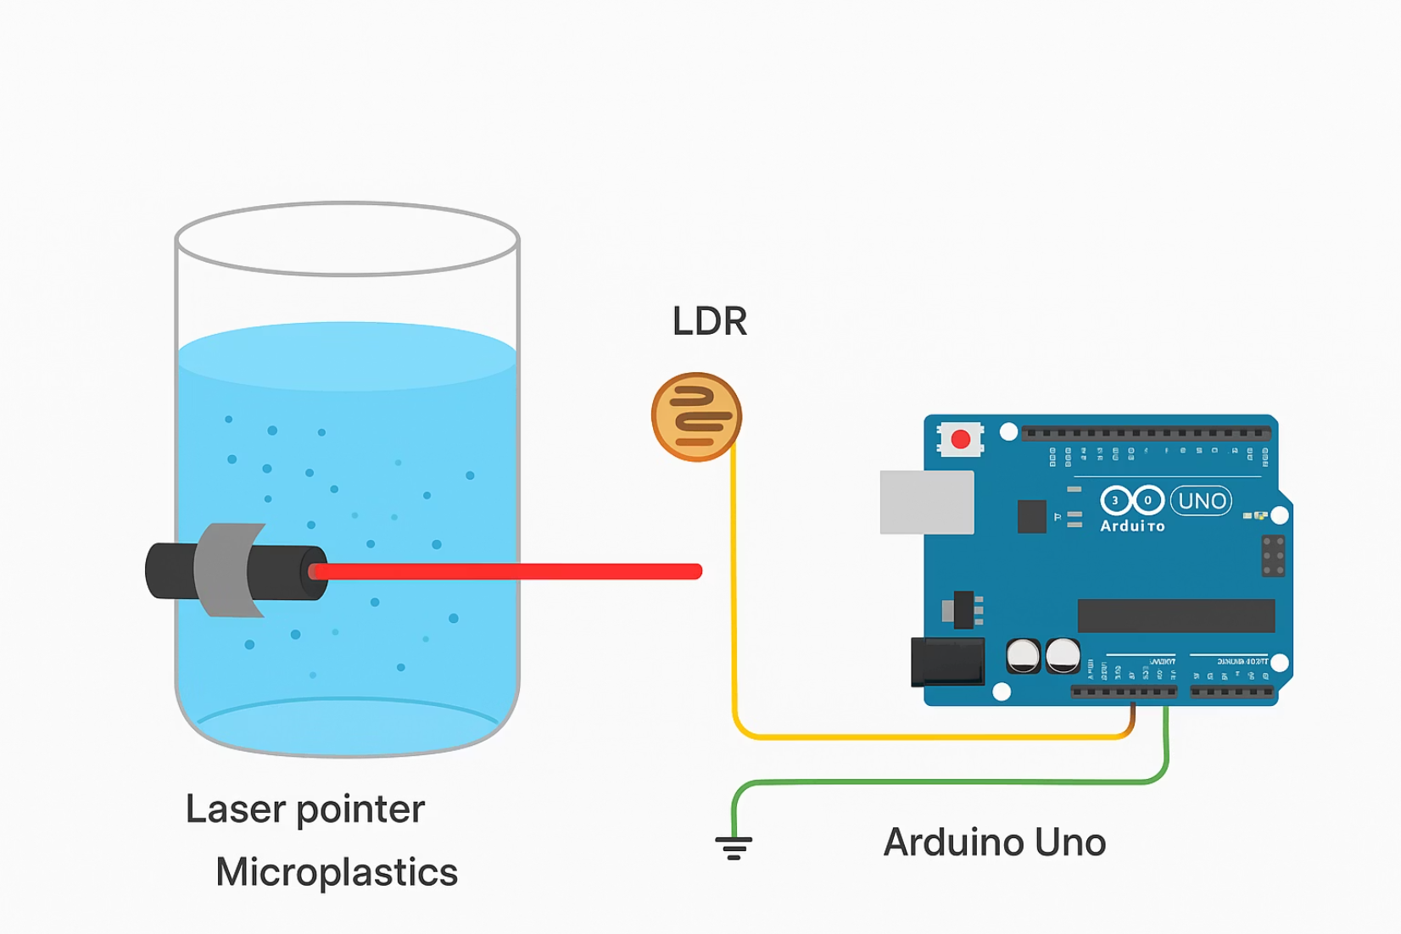
How It Works: Light Scattering Principle
Our detector operates on the fundamental principle of light scattering.
When a beam of light passes through water containing microplastics, these tiny particles interact with the light:
They scatter some of the light in various directions.
They absorb a portion of the light's energy.
This interaction leads to a reduction in the intensity of the original light beam that reaches a sensor placed directly opposite the light source. By measuring this decrease, we can infer the presence and concentration of microplastics.

Slide 6
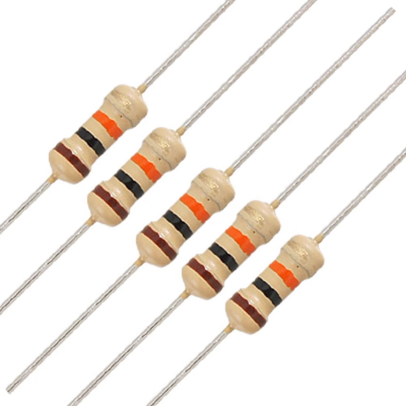
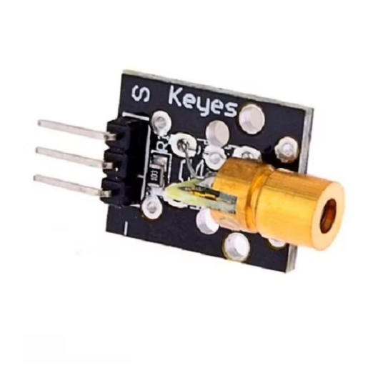
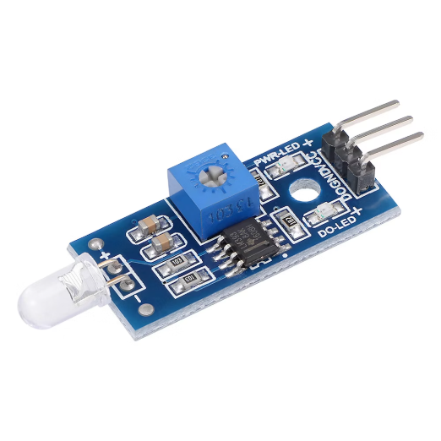
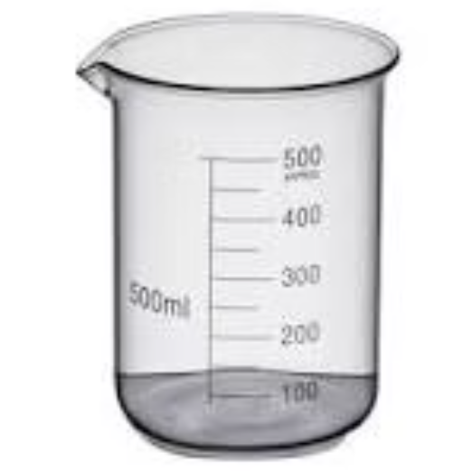
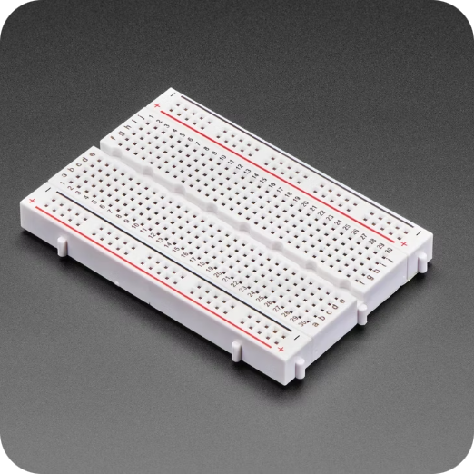
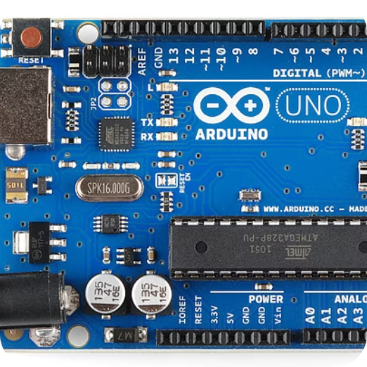
Essential Components for Assembly
Resistor (10k)
Laser Diode Module
Light Sensor (LDR/Photodiode)
Regulates the electrical current flow to the Light Dependent Resistor (LDR), ensuring its proper operation.
Emits a focused, monochromatic light beam through the water sample, crucial for light scattering detection.
Detects the intensity of the transmitted light after it passes through the water sample, converting it into an electrical signal.
Transparent Beaker/Container
Breadboard & Jumper Wires
Arduino UNO
Holds the water sample for testing, allowing unobstructed passage of the laser light.
Used for prototyping and easily connecting all the electronic components without soldering.
The brain of the system, responsible for processing sensor data and controlling other components.

Slide 7
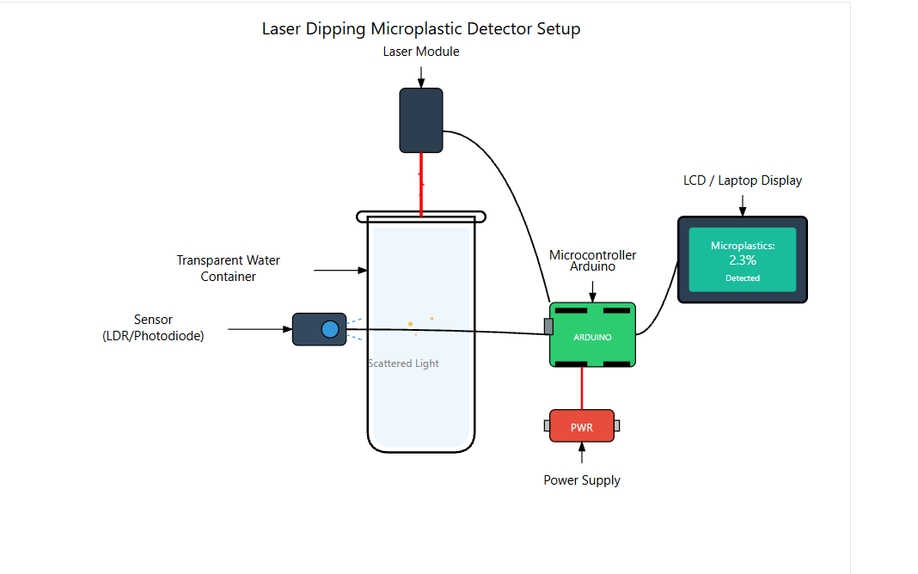

Optimal System Arrangement
Sample Container
A transparent beaker or acrylic container is used to hold the water sample, ensuring clear light transmission.
Laser Diode Placement
The laser module is securely fixed on one side of the transparent container, directing a focused beam through the water.
Primary Light Sensor
A light sensor (LDR/photodiode) is positioned directly opposite the laser, measuring the transmitted light intensity.
Optional Second Sensor (90°)
For enhanced sensitivity, a second sensor can be placed at a 90-degree angle to the light beam. This sensor detects the light specifically scattered by microplastic particles, offering another data point for analysis.

Slide 8
Code & Programming: The Brain of the Detector
The Arduino code is the operational core of our detector, enabling it to transform raw sensor data into meaningful insights.
It performs several critical functions:
01
02
03
Sensor Data Acquisition
Data Processing
Display Output
Reads the analog light intensity values from the LDR/photodiode, capturing the changes caused by microplastics in the water.
Based on pre-calibrated values, it calculates the percentage concentration of microplastics by comparing the detected light intensity to a clear water baseline, filtering out noise.
Formats and sends the calculated concentration to the 16x2 LCD screen for real-time display, providing immediate and understandable results to the user.

Slide 9
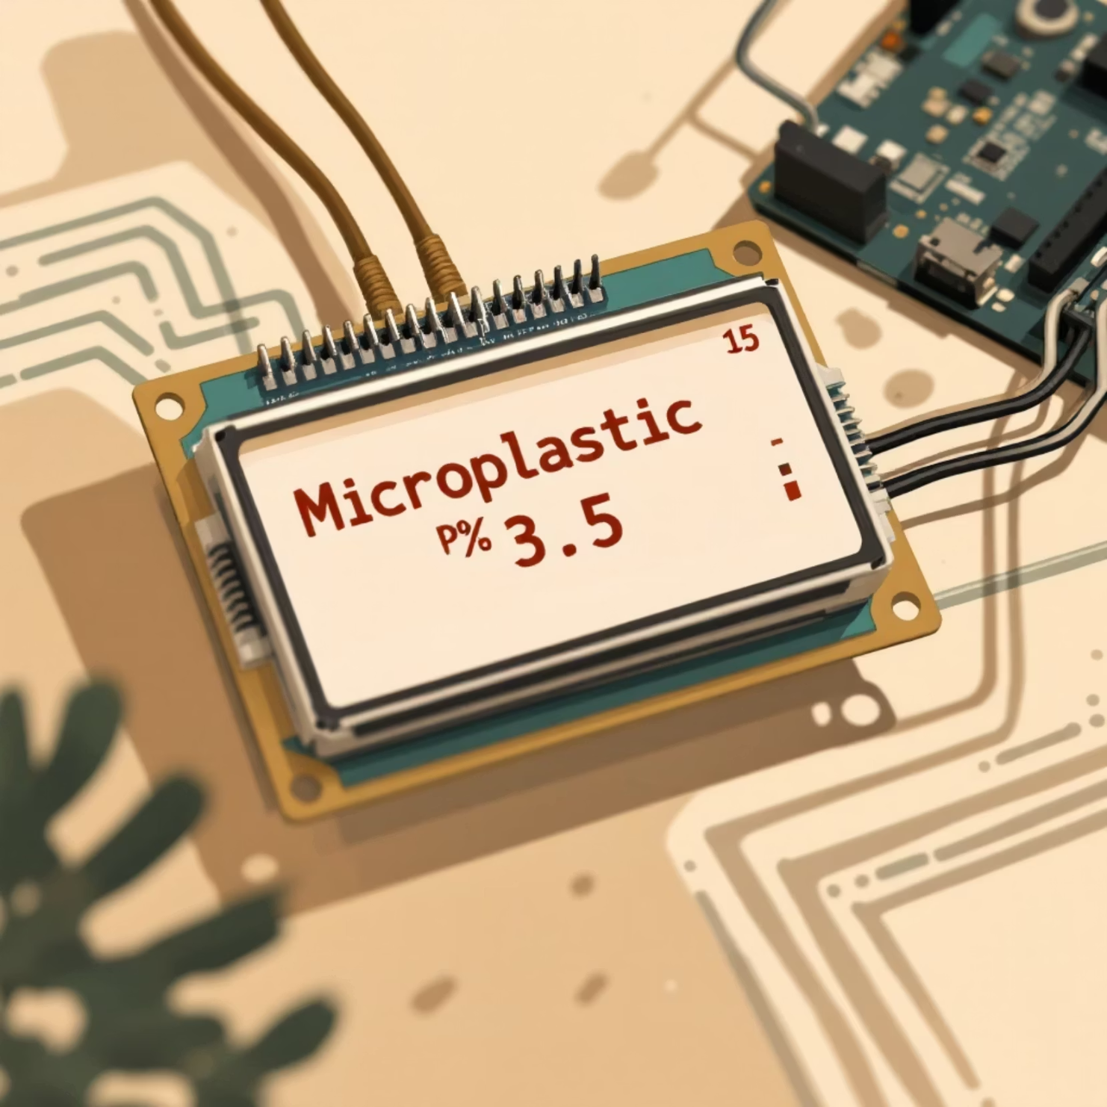
Interpreting the Output: Real-Time Results
The system's real-time display on the LCD screen makes immediate assessment possible.
The primary output is the percentage concentration of microplastics, indicating the relative turbidity caused by the plastic particles. For example, a reading of "5% MP" would mean a 5% reduction in light intensity due to microplastics compared to clean water.
This immediate feedback allows for quick environmental surveys and provides a tangible measure of water quality that is easy to understand, even for non-experts, facilitating rapid response to pollution events.

Slide 10


